Slide 1
Sample
Iteration Checkpoint
07 February 2007

Slide 2

Agenda
Review completed stories this iteration
Hands-on
Review overall progress towards the live date
Incomplete stories this iteration
Scope changes
Issues and risks review
Discuss and close on Iteration 5 stories and tests (exit criteria)
Feedback

Slide 3
Planned Stories this iteration
10. Final Look and Feel Appl.
6. Usability Test and Refactor
11. Home Page
7. CMS Conversion Activities
4. PMO activities
8. Training and Misc Activities
Develop approach and plan for procurement and productionization of wiki

Slide 4
Completed (and projected completed) stories this iteration
10. Final Look and Feel Appl.
6. Usability Test and Refactor
11. Home Page
7. CMS Conversion Activities
4. PMO activities
8. Training and Misc Activities
Develop approach and plan for procurement and productionization of wiki
See Screen flow next slide, and Demo
Notes:
CMS training – decided to forgo Harrahs review and allow this to close
Wiki Tech – in lieu of submission by Del, his email that he’s working on it
Boilerplate – got feedback from Del which was outstanding

Slide 5
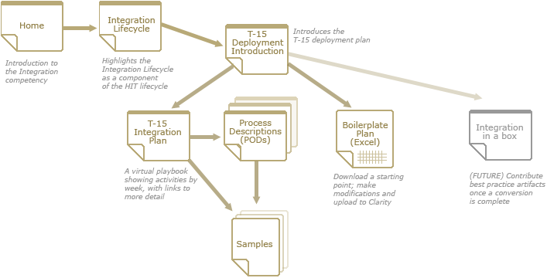
Screen flow
Pages for today’s walkthrough

Slide 6

Incomplete and blocked stories
Blocked
  7. CMS Conversion Activities
Incomplete
  10. Final Look and Feel Appl.
    Trying to incorporate last changes from graphic designer
    Pending incorporation of these and final review from Heath
    Also pending resolution of printing issue
  6. Usability Test and Refactor
  11. CMS Home Page

Slide 7
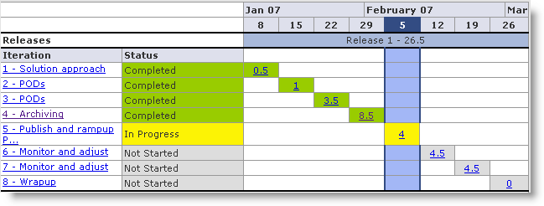
Overall progress

Slide 8
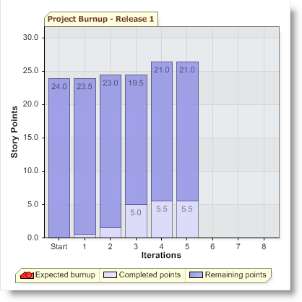
Burnup chart
Total Story Points for project: 26.5
Total completed thus far (projected): 5.5
Missed dependencies are the major reason for the slippage
We were not able to complete everything last week for the launch
We must focus this iteration on completing as much as possible today and tomorrow and focus Weds on Final QA
We will spend time later this week prioritizing backlog based on available bandwidth
Target live date: February 7th
Notes:
All our samples and everything that Sape is responsible for PODS done by 7th Feb. We write as many pods as we can write.
Anything that falls out of that will roll to Harrahs

Slide 9
Scope changes
Added two stories to monitor Confluence deployment
  Monitor Wiki certification process (iter 5)
  Monitor Wiki deployment process (iter 6)
Since production environment not ready, added story to deploy to production at Harrah’s and conduct QA again
  Migrate content to production and QA (iter 7)

Slide 10


Issues and risks review
Issues
  How do we deal with printing the Jump Page?
    Option 1: suggest not printing; refer to Excel
    Option 2: shorten description row
    Option 3: something else – find another widget?
  How much time will be available for backlog of stories?
    Iteration 6: Neil (50%) and Parker (100%) will be involved in training iteration 6
    Iteration 7: same, increasing for Neil
    Iteration 8: same, increasing for Neil
    may have to put some things on hold...
Risks and mitigations / contingency planning
  Executing Confluence with production DB may introduce issues
    We could migrate the work in progress version to MS-Sql (adding a story)
  Cannot close procurement of Confluence in time for golive
    Extending date of eval copy (DONE)
    Access to Development version at Harrah’s (certification issues)
    Use of offline version – this is our assumption for the Feb 7 release (makes it difficult for Harrah’s team to continue working during Feb).

Slide 11
Iteration 5 stories
Complete punch list
Perform final QA
Final review and acceptance session
See ResultSpace
  Stories
  Tests (exit criteria)

Slide 12

Feedback and next steps review
Notes:
Feedback:
Are we on time? (Next Step: will send out the list of backlog before Thursday)
Like changes on wiki up front

Slide 13
Feedback and next steps

